Slide 1
ARECANUT QUALITY AND PRICE PREDICTION
Department of Master of Computer Applications
Under the Guidance of
Ms. Sandhya N
Assistant Professor
Presented by:
Student Name: Shrivatsa Bhat
USN: 4NI22MC096

Slide 2
Contents:
Introduction
Objectives
Literature Survey
Methodology
Design Diagrams
Implementation
Screen Shots
Conclusion
References

Slide 3
Introduction
The arecanut industry plays a crucial role in the agricultural sector, with arecanut being a significant cash crop in many regions. However, manual grading processes and market price fluctuations pose challenges for producers and traders. By leveraging image processing techniques and machine learning algorithms, we seek to streamline grading processes, improve accuracy, and provide stakeholders with valuable insights for better decision-making

Slide 4
Objectives
Develop a computer vision system capable of accurately grading arecanuts based on key attributes such as color, texture, and size.
Implement machine learning algorithms for predicting market prices of arecanuts, taking into account factors such as quality grade, regional variations, and market trends.
Provide a user-friendly interface for stakeholders to interact with the system, accessing quality assessments and price predictions seamlessly.

Slide 5
Literature Survey
TITLE:-Possible Approaches to Arecanut Sorting / Grading using Computer Vision: A Brief Review
The paper explores the application of computer vision techniques, including back propagation neural network classifier and hybrid approaches, for sorting and grading Arecanut based on color, texture, and shape attributes, aiming to enhance agricultural productivity and efficiency.
2. TITLE:-Arecanut Grade Analysis using Image Processing Techniques
The paper presents a computer vision-based grading system for boiled Arecanuts, employing image processing techniques such as HSV histogram color transform and Gabor filter for feature extraction, and utilizing a Support Vector Machine (SVM) classifier to categorize Arecanuts into different grades, aiming to streamline the labor-intensive grading process in Arecanut marketing.
3. TITLE: FORECASTING ARECA NUT MARKET PRICES USING THE ARIMA MODEL: A CASE STUDY OF INDIA
The study utilizes Box Jenkins ARIMA methodology to forecast prices of a new Areca nut variety in Karnataka, with ARIMA (3, 1, 3) selected as the suitable model through diagnostic checks using ACF and PACF correlograms, highlighting the iterative process of model development for enhancing forecasting accuracy.

Slide 6
4. TITLE: Applications of Image Processing in Agriculture: A Survey
The paper provides a comprehensive survey of image processing applications in agriculture, covering techniques such as segmentation, weed detection, and fruit grading, and discussing methodologies like remote sensing and neural networks to enhance decision-making processes and improve agricultural practices.
5. TITLE: Machine Learning Applications in Agriculture
The paper discusses the importance of precision agriculture in addressing food security challenges posed by the projected global population increase, emphasizing the role of machine learning, including techniques like leaf water content estimation, crop mapping, irrigation detection, crop selection prediction, disease detection, crop yield prediction, and crop row detection, in enhancing agricultural productivity and sustainability.
6. TITLE: Quality Inspection and Grading of Agricultural and Food Products by Computer Vision- A Review
The paper provides an overview of computer vision applications in quality inspection and grading of various agricultural and food products, showcasing methodologies such as colour segmentation, image processing, and machine vision techniques used for assessing quality attributes like sweetness prediction in oranges, size and shape sorting of strawberries, sorting oil palm fruits, quality assessment of tomatoes, grain classification, pizza quality evaluation based on visual features, and image-based grading for meat products.

Slide 7
Methodology
Data Collection
Image Dataset: Collected arecanut images labeled as q1, q2, q3 for quality classification.
Price Dataset: Compile historical price data for different varieties and grades.
Data Preprocessing
Image Processing: Resize images to a uniform size, normalize pixel values, and apply data augmentation techniques.
Price Data Cleaning: Handle missing values, convert date columns to datetime, and extract features like year, month, and day.
Feature Extraction
Image Features: Use a CNN model to extract features and classify quality.
Price Features: Utilize date and variety information to predict prices.

Slide 8
Model Development
Quality Prediction: Train a CNN model for image classification into quality grades.
Price Prediction: Use Random Forest Regression for price prediction based on historical data.
Deployment
Flask Application: Deploy the models using a Flask web application for user interaction.
If you need more details or specific sections expanded, let me know!

Slide 9
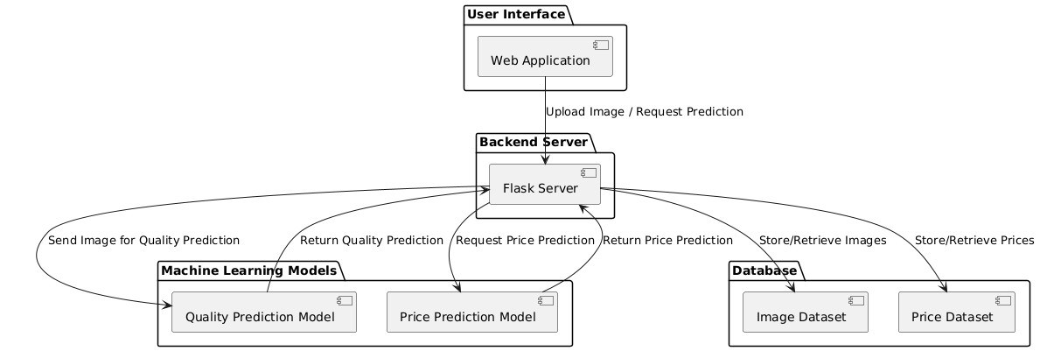
System Architecture

Slide 10
Implementation
Imports and Setup:
Uses TensorFlow and Keras for deep learning.
Defines directories and categories for arecanut images.
Data Preprocessing:
Uses ImageDataGenerator for data augmentation on training images (rescaling, flipping, rotation, etc.).
Prepares data generators for training, validation, and testing datasets.
Model Definition:
Loads the VGG16 model without the top layer, using pre-trained weights.
Freezes the VGG16 layers to prevent them from being retrained.

Slide 11
Training:
Utilizes early stopping to prevent overfitting by monitoring validation loss.
Trains the model using the training data generator.
Evaluation:
Evaluates the model's performance on the test dataset.
Saves the trained model for future use.

Slide 12
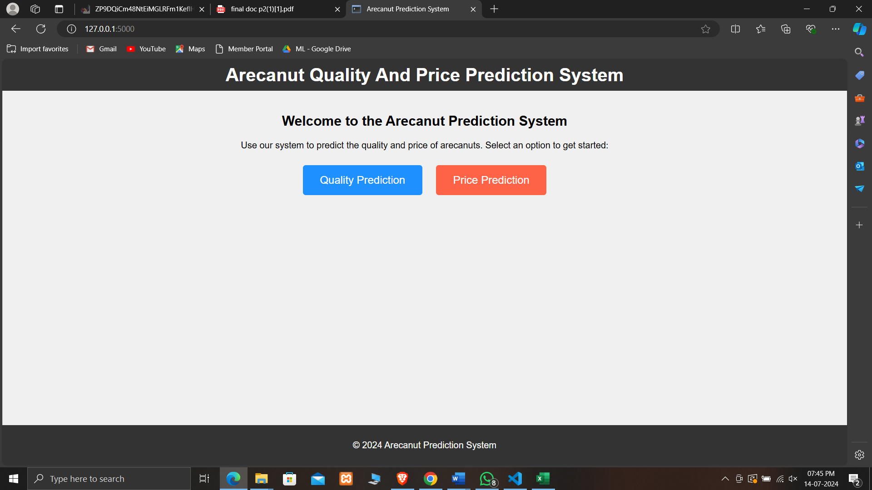
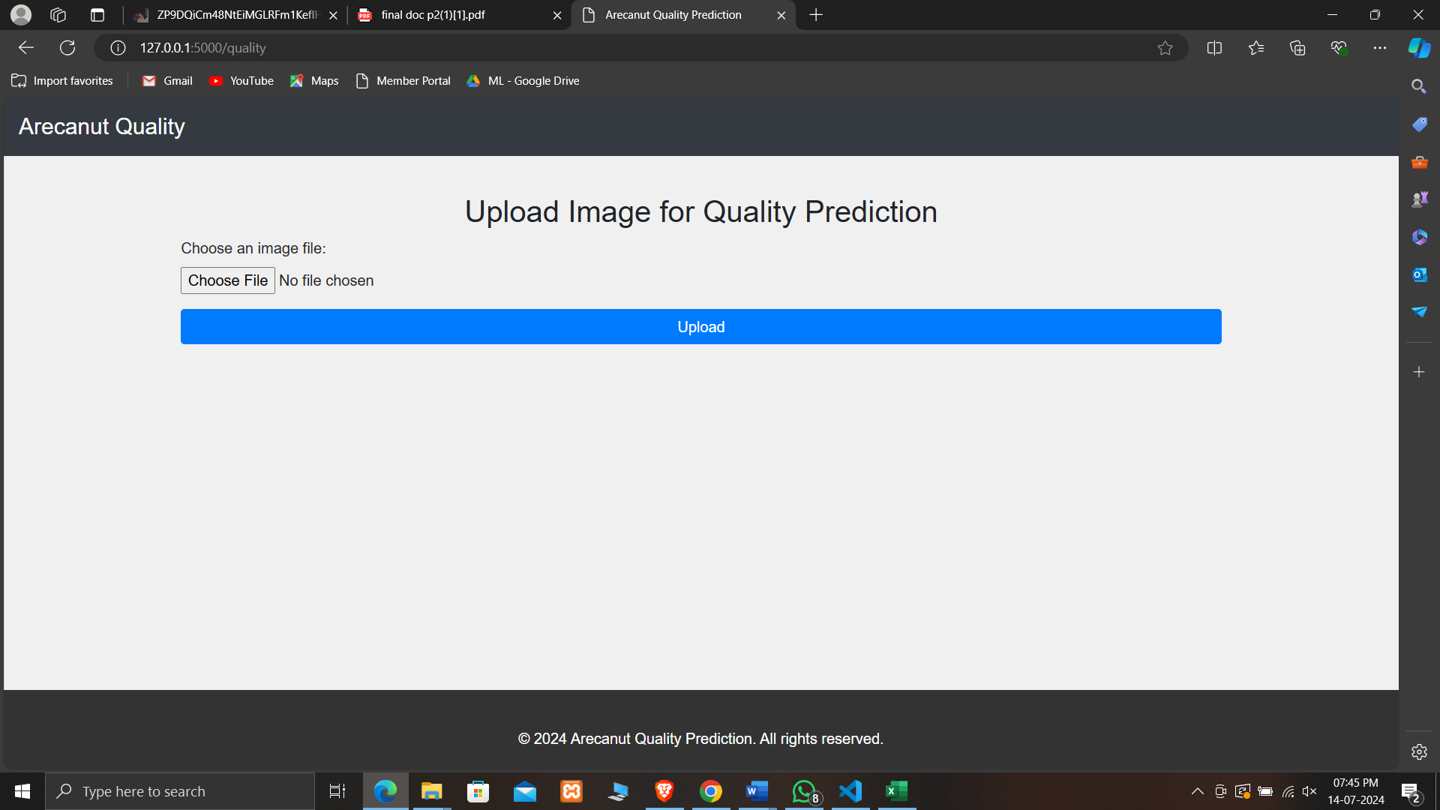
Screen Shots

Slide 13
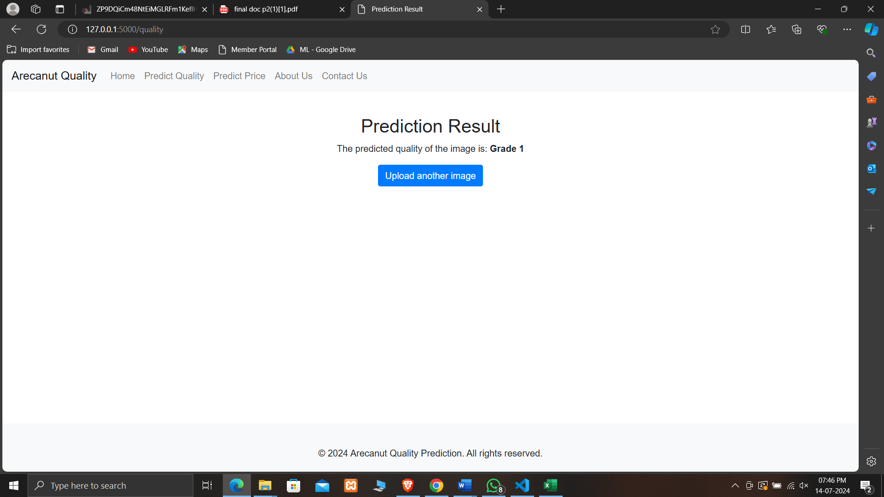
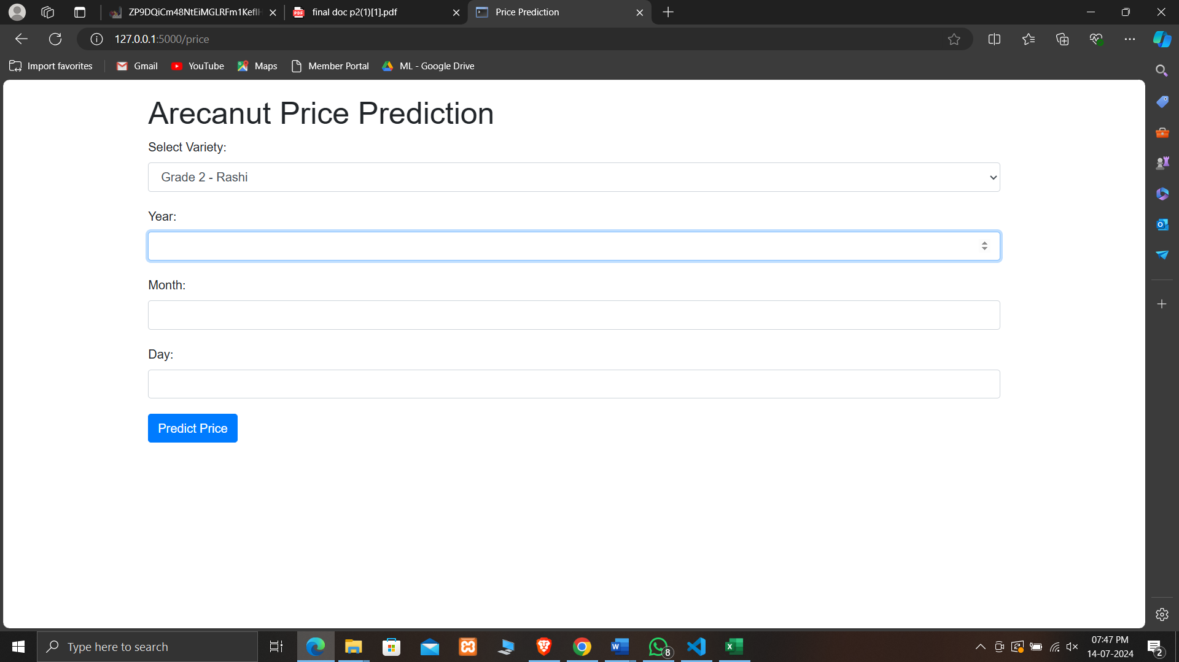
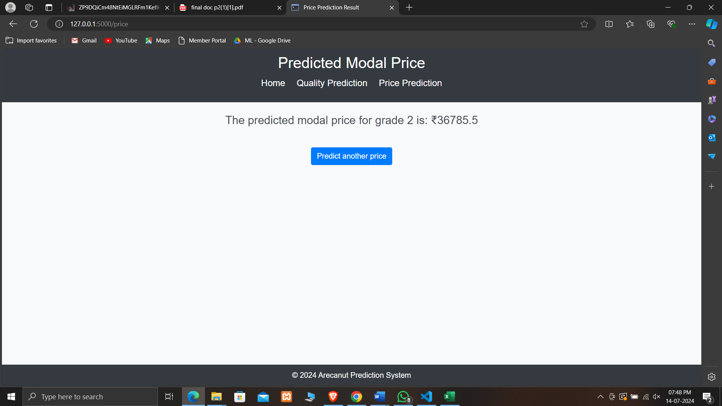

Slide 14
Conclusion
By integrating advanced image processing techniques and predictive analytics, we aim to streamline arecanut assessment and enhance market transparency. This innovative approach not only saves time and labor but also improves the accuracy of quality grading and price predictions.

Slide 15
References
Possible Approaches to Arecanut Sorting / Grading using Computer Vision: A Brief Review By Bharadwaj N K, Dr. Dinesh R
Arecanut Grade Analysis using Image Processing Techniques By Pushparani M.K, Dr. D Vinod Kumar, Dr. Abdulla Gubbi
Applications of Image Processing in Agriculture: A Survey By Anup Vibhute, S K Bodhe
Machine Learning Applications in Agriculture By Hakkim, V., Joseph, E., Gokul, A., and Mufeedha, K.
Quality Inspection and Grading of Agricultural and Food Products by Computer Vision- A Review By Narendra V G Hareesh K S

Slide 16
Image Processing and Machine Learning for Automated Fruit Grading System: A Technical Review By Rashmi Pandey, Sapan Naik, Roma Marfatia
Automatic Fruit Grading and Classification System Using Computer Vision: A Review By Seema, A. Kumar and G. S. Gill
Machine Vision based Real Time Cashew Grading and Sorting System using SVM and Back Propagation Neural Network By Reena Mary George, Shyna A
FORECASTING ARECA NUT MARKET PRICES USING THE ARIMA MODEL: A CASE STUDY OF INDIA By Abhaya K. Kumar, Prakash Pinto

Slide 17
THANK YOU

